Slide 1
The Roman Republic
Chapter 8
Section 2

Slide 2
Timelines
Section 1
Section 2
In 509 BC Romans overthrew the Tarquins and became a republic.

Slide 3
Reminder…
From Section 1, a republic is…
A form of government in which there is no king or queen but is someone who is chosen by voting citizens.

Slide 4
Where?

Slide 5
Two Classes of Citizens
Patricians—Patricians were the upper ruling class, the wealthy landowners
Plebeians—commoners, small farm owners, artisans, and shop keepers.

Slide 6
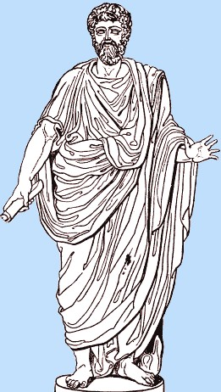
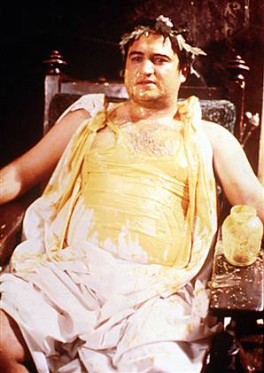
The “Pa’s”

Slide 7
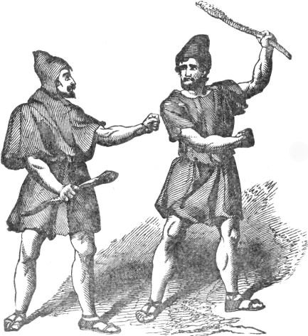
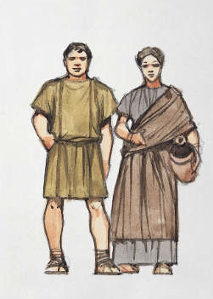
The “Pleb’s”

Slide 8
How Roman Government Worked
The Romans had a three part (tripartite) government, in some ways like what we have today:
One group ran the government
Another group made the laws
And another group acted as judges

Slide 9
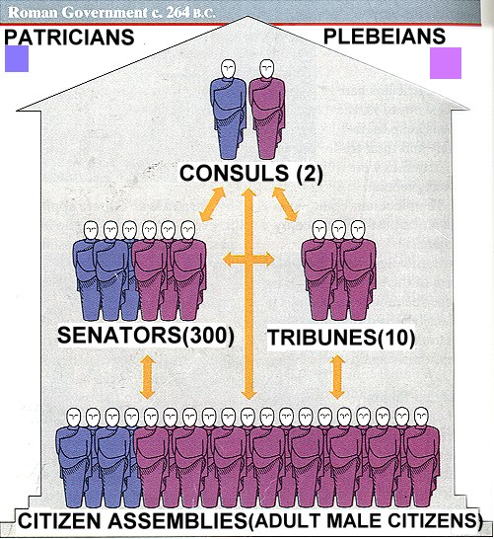
Top Government Officials Were Called “Consuls”

Slide 10
Consuls—2, both patricians; chosen every year; headed the army and ran the government.
Veto—reject or oppose.
Praetor—interpret and act as judges in court.

Slide 11
How Did The Pleb’s Get More Power?
Plebians wanted more power—so they went on strike; they refused to serve in the army and many even left the country.
The Pa’s needed them, so they agreed to share some power with them.

Slide 12
Cincinnatus
Cincinnatus was a popular dictator. He was not a tyrant.
The Roman people turned to him to save them when a powerful enemy surrounded their army.

Slide 13
Lucius Quinctius Cincinnatus

Slide 14
Roman Laws
The legal system of the United States is based on ancient Roman laws.
Rome’s first written laws were called the Twelve Tables, written in 451 BC.
Written laws protected everyone from unfair treatment.
The Twelve Tables were protected only Roman citizens.

Slide 15
Rome Expands

Slide 16
The First Punic War
Rome wanted more territory after all of Italy was theirs.
Rome had an enemy, Carthage, that wanted territory too.
Both Rome and Carthage wanted Sicily.
The wars over Sicily were called the first Punic War. Rome won. Carthage lost.

Slide 17
Second Punic War
Carthage tried to conquer Spain and northern Africa after they lost Sicily to Rome.
Rome trained the Spanish to rebel against Carthage. Carthage didn’t like that!
To Punish Rome, Carthage sent Hannibal to attack Rome. This started the second Punic war.
Rome then invaded Carthage, so Hannibal had to leave Italy to protect his homeland, Carthage. Rome defeated Carthage, again.

